Slide 1
Crabs
By: Christian Wehrly and Adam Rutz

Slide 2
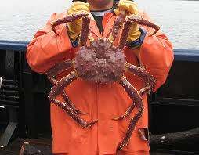
Classification of Crabs
Kingdom: Animalia
Phylum: Arthropoda
Class: Crustacea
Order: Decapoda
Family: Lithodidae
Genus: Paralithodes
Species: Paralithodes camtschatica

Slide 3
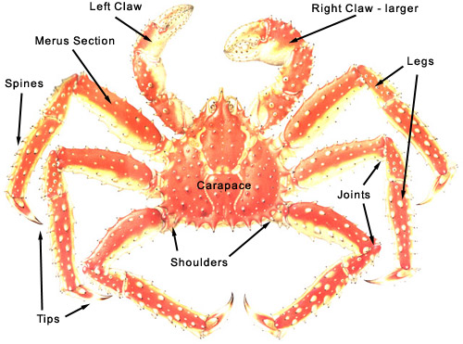
Body Plan
5 sets of legs and 2 antennae
Exoskeleton with waxy finish for protection.
Reduced abdomen and enlarged and broadened anterior portion of the body
Nervous system- brain and ganglia
Circulatory system- heart and blood vessels
Respiratory- Branchial chamber, gills and apertures (openings to the outside)
Digestive system- Mouth and mouth parts, gut system, intestine, anus
Muscular system- mouth parts, legs, muscles and joints.

Slide 4
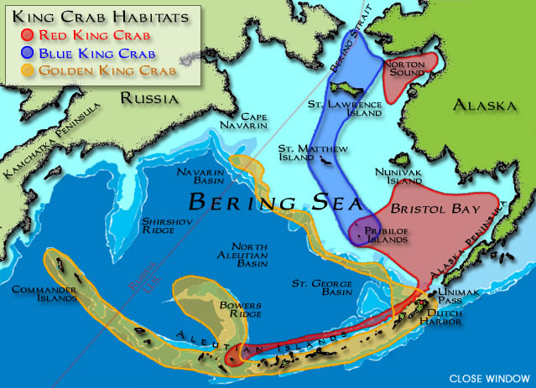
Habitat
The king crab lives in the cold waters off of the coasts of Russia and the continental North America
Predators include: some fish, octopuses and sea otters
There are no competitors to the King Crab in its region
The crabs are predators who hunt at night
They eat fish, mollusks, barnacles, etc.

Slide 5
Body Structure-Function Relationship
Shell-Protection and camouflage
Pinchers-catch and kill food
Legs-move around the sea floor with traction
Joints-allow for greater movement to catch prey
Compound eyes-see in the dark/underwater
Mouth-can crush hard things like shells

Slide 6
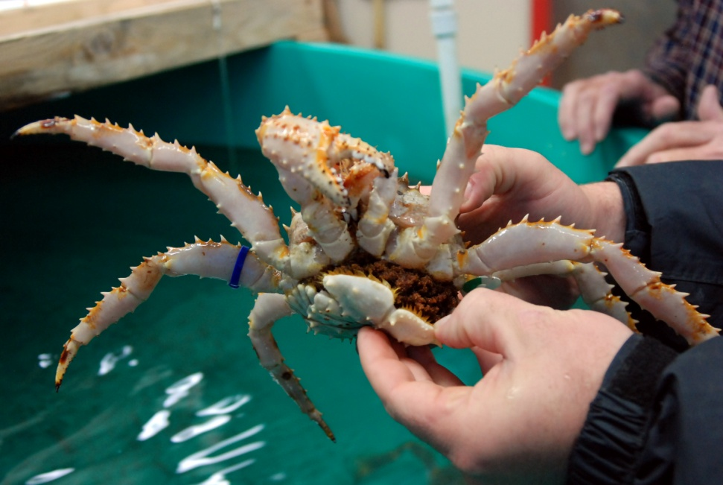
Reproduction and
Body Systems
Reproduce through external fertilization
Females are polygynous – mating once a year
Females release 150000 to 400000 eggs at one time
They have gills
Use an open circulatory system

Slide 7
What makes Crabs Unique/Interesting facts
*The crab's teeth are in their stomachs.
*The crab's scientific name is Callinectes sapidus [call-in-ek-tis sap-ah-dis].
*Average crabs live no longer than 3 years.
*The biggest crab in Maryland was a male which measured 9 in.
*Crabs are also called decapods.
*Decapod means 10 legs.
*Callinectes sapidus means "beautiful swimmer".
*The swim paddles help the crab swim.
*If a crab loses its claw, the claw grows back.
Crabs walk sideways
They are also canibalistic

Slide 8
Bibliography
Works Cited
"Buying, Cooking, and Serving King Crab Legs." FishEx / Fisherman's Express - Alaska King Crab and Seafoods. N.p., n.d. Web. 6 Apr. 2011. <http://www.fishex.com/seafood/crab/buying-king-crab.html>.
"Classification." BioWeb Home. N.p., n.d. Web. 6 Apr. 2011. <http://bioweb.uwlax.edu/bio203/s2007/luchsing_sara/classification.htm>.
"Crabs." Cyber Haus Computer Consulting, Web and Book Publishing. N.p., n.d. Web. 6 Apr. 2011. <http://www.cyhaus.com/marine/crabs.htm>.
"Introduced species - Red king crab ( Paralithodes camtschaticus)." BarentsPortal. N.p., n.d. Web. 6 Apr. 2011. <http://www.barentsportal.com/barentsportal09/index.php?option=com_content&view=article&id=367&Itemid=268&lang=en>.
"King Crab 101 - Alaska King Crab Facts." FishEx / Fisherman's Express - Alaska King Crab and Seafoods. N.p., n.d. Web. 6 Apr. 2011. <http://www.fishex.com/seafood/crab/king-crab-101.html>.
Photography, Crappy Wildlife. "Red King Crab (Paralithodes camtschaticus) | Flickr - Photo Sharing!." Welcome to Flickr - Photo Sharing. N.p., n.d. Web. 6 Apr. 2011. <http://www.flickr.com/photos/crappywildlifephotography/771670915/>.

